Slide 1

Design and Development of an IoT-Enabled Health Condition Monitoring Kit
Thesis Defense
Supervised By:
Prof. Dr. Md. Aminul Haque Akhand
Prof. Dr. Md. Sheikh Sadi
Presented By:
Name: Arpita Das
Roll: 1607067
Name: Shimul Dey Katha
Roll: 1607086
Department of Computer Science and Engineering
Khulna University of Engineering and Technology, Khulna-9203, Bangladesh

Slide 2
Presentation Outline
Introduction
Problem Statement
Objectives
Related Works
Methodology
Experimental Analysis
Conclusions
References

Slide 3
Introduction

Slide 4
Problem Statement
Health is a primary concern of every human being. Several life threatening diseases can be easily monitored by IoT enabled health monitoring kit.
Raspberry Pi can be used as an core device for wireless communication and cloud communication.
However, IoT enabled health monitoring system might be an effective solution with less complications.

Slide 5
Objectives
To develop a continuous health condition monitoring kit.
To monitor the health conditions such as:
1. Body temperature,
2. Heart beat,
3. Movement of the body,
4. Sweat gland activity related to emotional arousal,
5. Blood oxygen level and
6. Blood Pressure.
Admin can see the health condition of the patient from anywhere through the firebase database.

Slide 6
Related Works
Table 1: Observation on Existing Systems
Author | Year | Display Device | Hardware Components | IoT Enabled
Nookhao et al. [2] | 2020 | LCD display and computer | Temperature sensor,heart beat sensor,arduino,WIFI module | Yes
Priya et al. [3] | 2019 | Monitor or smartphone | Body temperature sensor,pulse rate sensor,Raspberry pi | Yes
Tariq et al. [18] | 2019 | Smartphone | Heart beat sensor | No

Slide 7
Methodology

Slide 8
System Overview
The health condition monitoring kit which is proposed mainly developed in two parts:
a)Sensor’s data acquisition.
b)Data analysis, storage and visualization to the cloud.
The system follows three tier architecture.

Slide 9
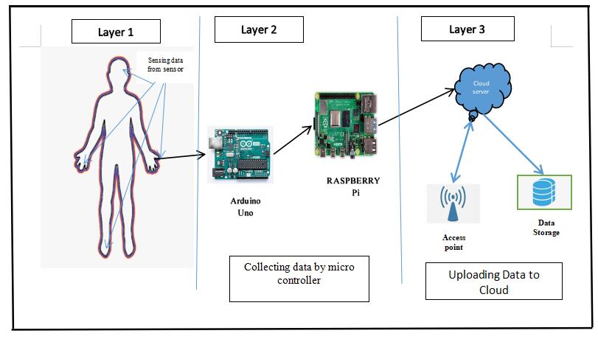
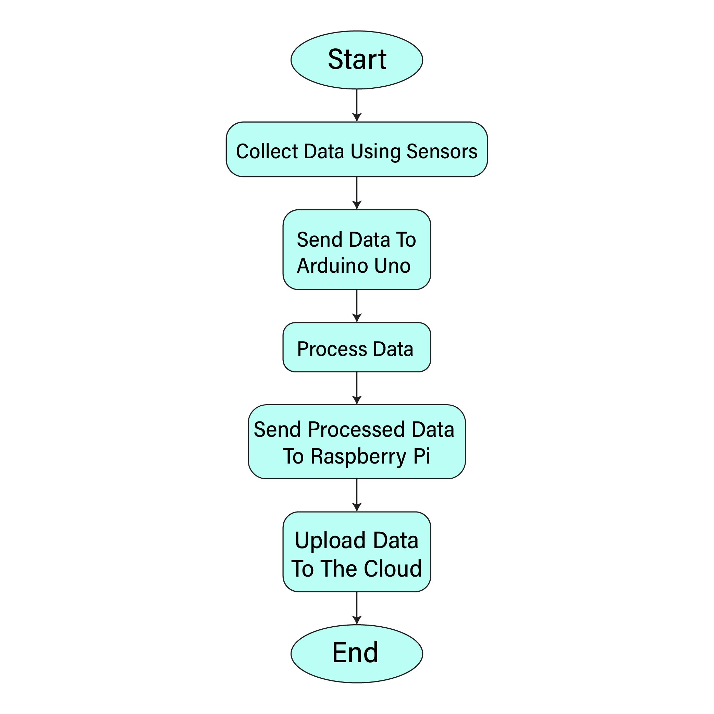
System Overview (cont.)
Layer1
Layer2
Layer3
Fig. 2: The data flow of the system.
Fig. 1: The flow diagram of the system.

Slide 10
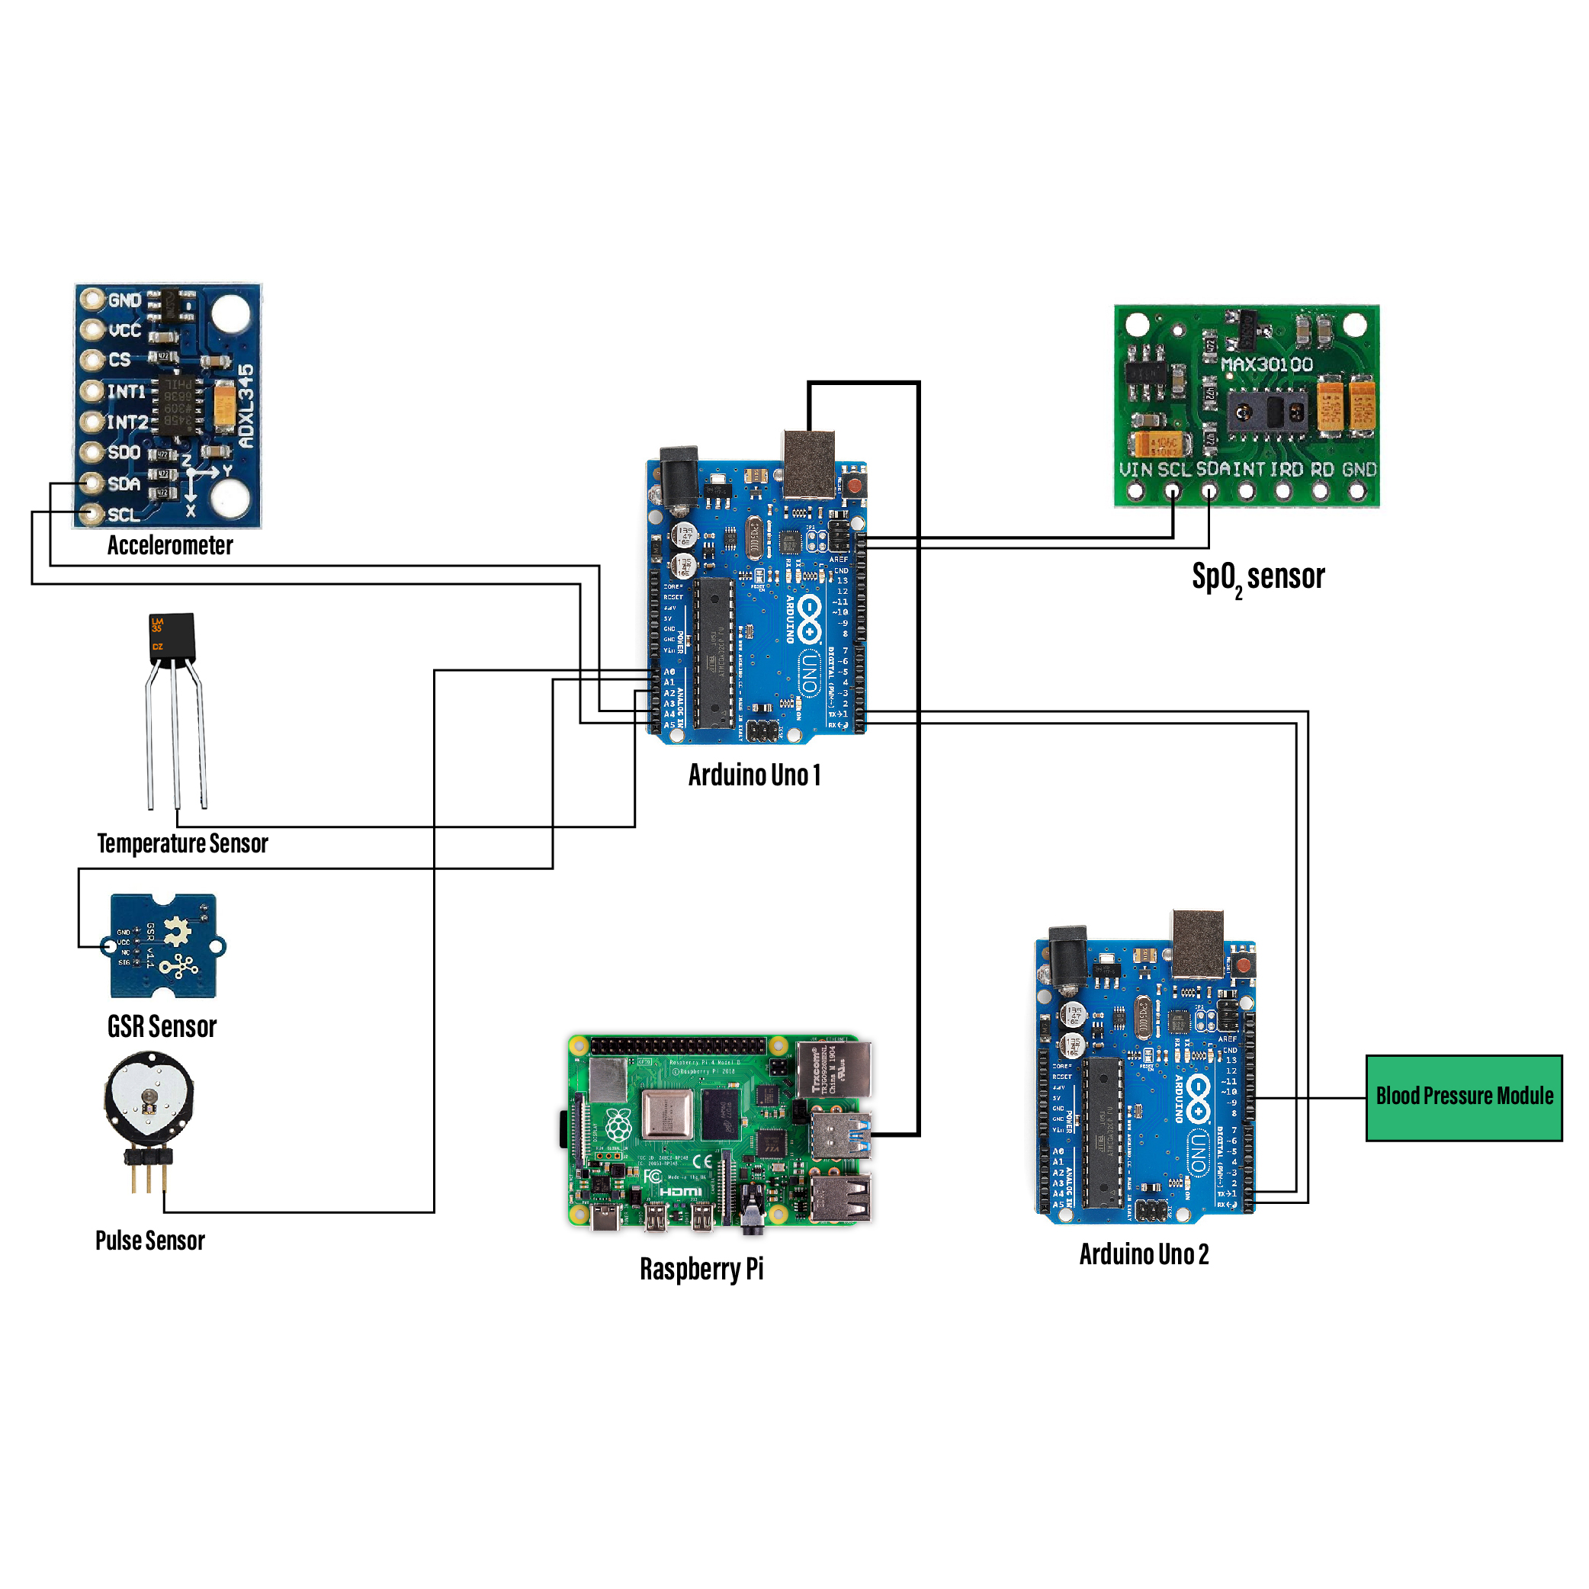
Hardware Implementation
Table 2: Sensor Equipments.
Health Parameter | Sensor
Body Temperature | LM35 sensor
Heartbeat | Pulse sensor
Body motion | adxl345 accelerometer sensor
Sweat glant activity | GSR sensor
Blood oxygen level(SpO₂) | MAX30102 pulse oximeter
Blood pressure | Developed by ourself
Serial Communication
Blood Pressure Module
Fig. 3: The Schematic Circuit of the System.

Slide 11
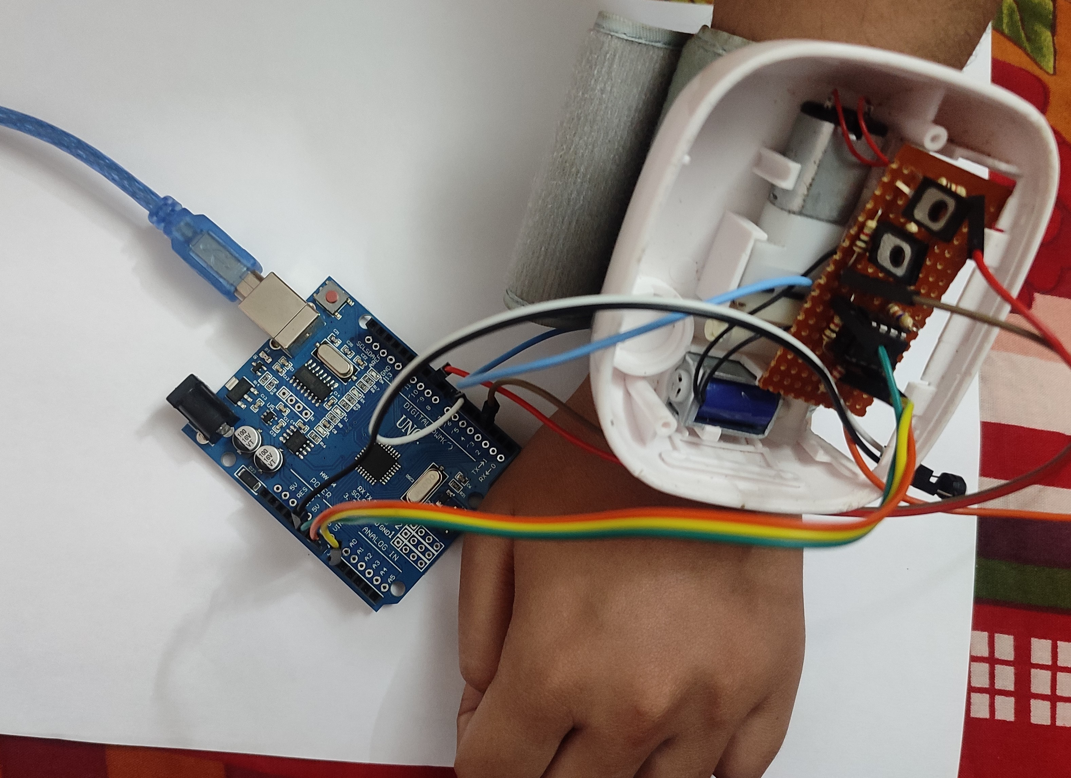
Blood Pressure Module
BP module composed of two parts:
Hardware part:
Arduino board,
An air pump,
An air valve,
An inflatable cuff,
A pressure sensor and
An amplifier circuit.
Software Part:
1. Arduino IDE
Fig. 4: Circuit of blood pressure module.

Slide 12
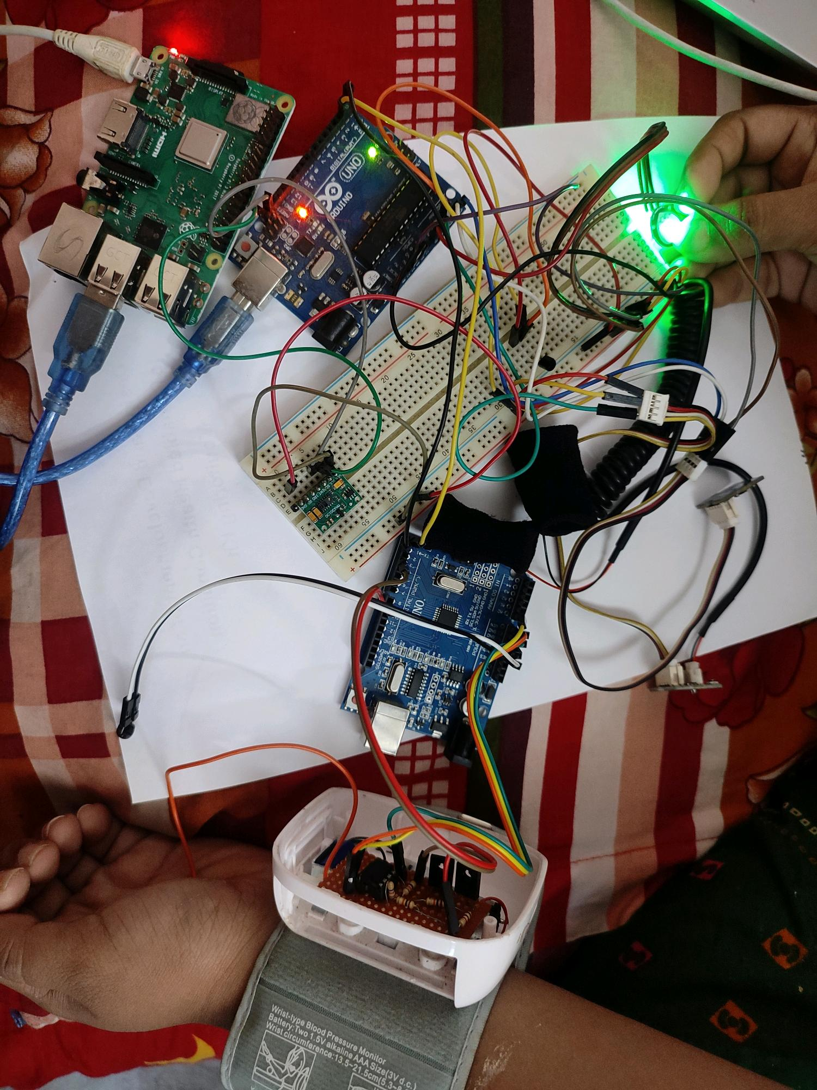
Integrated System
Heartbeat Module
Temparature Module
SpO₂ Module
GSR Module
Accelerometer Module
Blood PressureModule
Fig. 5: The Circuit of the System.

Slide 13
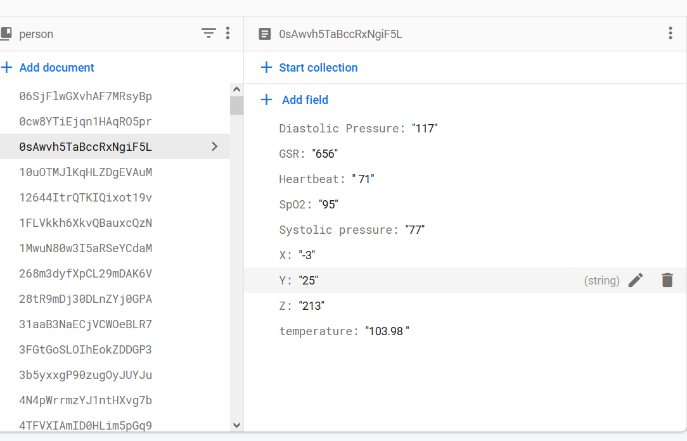
Data Upload
Fig. 6: Upload data to firebase cloud database.

Slide 14
Experimental Analysis

Slide 15
Performance Analysis
The evaluation of the research to check the performance is done by several experiments.
The health parameter values have been monitored during the working of the project.
The examination of the system is done by several tests.

Slide 16
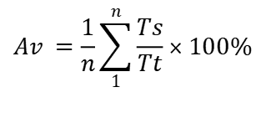
Performance Analysis: Body Temperature
The body temperature is measured and compared with the actual tempratature measured using thermometer.
Table 3: Comparison between Measured temperature and Actual temperature.
Users | Temperatureusing lm35, F | Temperatureusing thermometer, F | Average accuracy
User1 | 95.4 | 98.4
User2 | 100.3 | 100.6
User3 | 96.3 | 99.0 | 96.19%
User4 | 93.3 | 98.0
User5 | 89.9 | 97.9
accuracy calculated using equation-
$$Av =\frac{1}{n}\sum_{1}^{n}{\frac{Ts}{Tt}}×100\%$$

Slide 17
Performance Analysis: Heartbeat
Heartbeat measured in BPM.
Table 4: Comparison between measured heartbeat and actual heartbeat.
Users | Heartbeatusing pulse sensor, bpm | Normal heartbeat, bpm | Average accuracy
User1 | 76 | 78
User2 | 79 | 82
User3 | 88 | 89 | 96.77%
User4 | 81 | 84
User5 | 90 | 95

Slide 18
Performance Analysis: Body Motion
Motion of a user in X, Y and Z axes.
Table 5: Accelerometer sensor value of an user.
 | X axis value | Y axis value | Z axis value
Before motion | -4 | 25 | 213
Before motion | -4 | 25 | 213
After motion | 62 | 13 | 204
After motion | 74 | 12 | 195

Slide 19
Performance Analysis: GSR value
Table 6: GSR sensor values for different users.
User | GSR data
User1 | 195
User2 | 199
User3 | 201
User4 | 190
User5 | 210

Slide 20
Performance Analysis: SpO₂ and Blood pressure
Table 7: SpO2 sensor values and blood pressure values for different users.
Users | Blood Oxygen Level(%) | Blood Pressure
 |  | Systolic | Diastolic
User1 | 95 | 78 | 125
User2 | 96 | 82 | 130
User3 | 95 | 85 | 135
User4 | 97 | 84 | 135
User5 | 96 | 75 | 120

Slide 21
Performance Analysis (cont.)
Table 8: Comparison Between Existing Systems and Proposed System
 | Temparature Sensor | Heartbeat Sensor | Accelerometer Sensor | GSR Sensor | SpO₂ Sensor | Blood pressure Module | IoT Enabled
Nookhao et al. [1], 2020 | Yes | Yes | No | No | No | No | Yes
Priya et al. [2], 2019 | Yes | Yes | No | No | No | No | Yes
Tariq et al.[3], 2019 | No | Yes | No | No | No | No | No
Proposed System | Yes | Yes | Yes | Yes | Yes | Yes | Yes

Slide 22
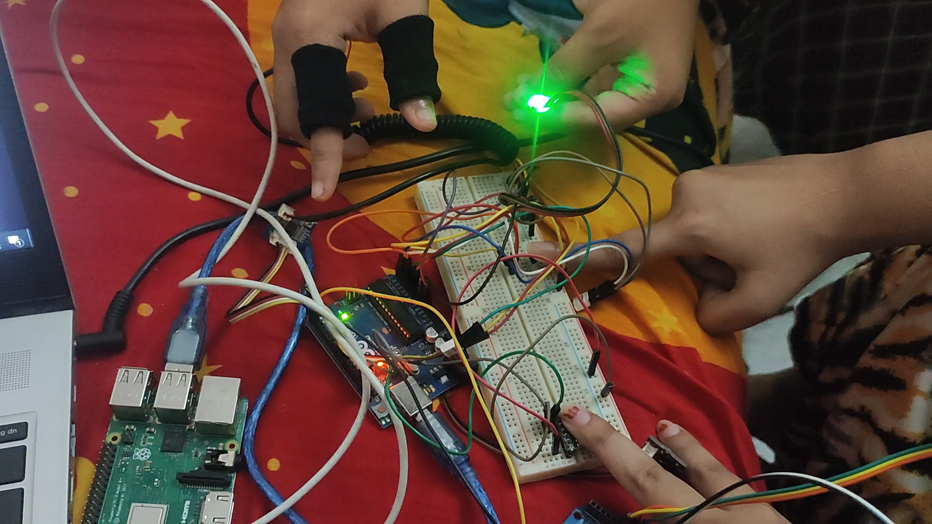
System Demonstration

Slide 23
Conclusions

Slide 24
Concluding Remarks
We designed a system to monitor health parameters of a person and visualized parameter data anywhere anytime using IoT.
The developed system is a user friendly system.
Though many improvement can be made to the system, it can play an important role in health monitoring sector.

Slide 25
Future Works
More health parameters (EEG,ECG) can be added.
Data storage system with ensuring data security can also be added.

Slide 26
Publication from the Thesis
Das Arpita, Shimul Dey Katha and Muhammad Sheikh Sadi. "An IoT Enabled Health Monitoring Kit Using Non-Invasive Health Parameters." In 2021 International Conference on Automation, Control and Mechatronics for Industry 4.0 (ACMI), pp. 1-6. IEEE, 2021.
https://doi.org/10.1109/ACMI53878.2021.9528227

Slide 27
References
[1] Nookhao, S., Thananant, V., Khunkhao, T.: Development of IoT Heartbeat and Body Temperature Monitoring System for Community Health Volunteer. Joint International Conference on Digital Arts, Media and Technology with ECTI Northern Section Conference on Electrical, Electronics, Computer and Telecommunications Engineering (ECTI DAMT NCON). pp. 1–4. (2020)
[2] Priya, A. D., Sundar, S.: Health Monitoring System using IoT. International Conference on Vision Towards Emerging Trends in Communication and Networking (ViTECoN). pp. 1–3. (2019)
[3] T. Tariq, R. M. A. Latif, M. Farhan, A. Abbas and F. Ijaz, "A Smart Heart Beat Analytics System Using Wearable Device," 2nd International Conference on Communication, Computing and Digital systems (C-CODE), pp. 137-142, 2019.

Slide 28
Thank You

